Slide 1
RF Direction Detection Team 2
Sylvie Sorese, Ryan Clayton, & Dalton Mitchum

Slide 2
Goal
The design of an affordable system that detects the direction of arrival of a radio frequency (RF) propagating wave, in the ISM band, with the intention of eventually being used in a classroom setting

Slide 3
Definitions, Acronyms, and Abbreviations
· Radio frequency (RF)
· Industrial, Scientific, and Medical (ISM)
· Direction of Arrival (DoA)
· Low-noise Amplifier (LNA)
· Software Defined Radio (SDR)
· Embry-Riddle Aeronautical University (ERAU)
· Institute of Electrical and Electronics Engineers (IEEE)
· Antennas and Propagation Society (AP-S)
· Continuous Time (CT)

Slide 4
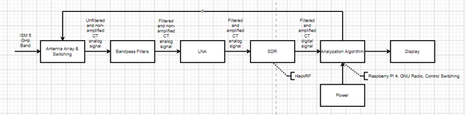
Case Diagram of System

Slide 5
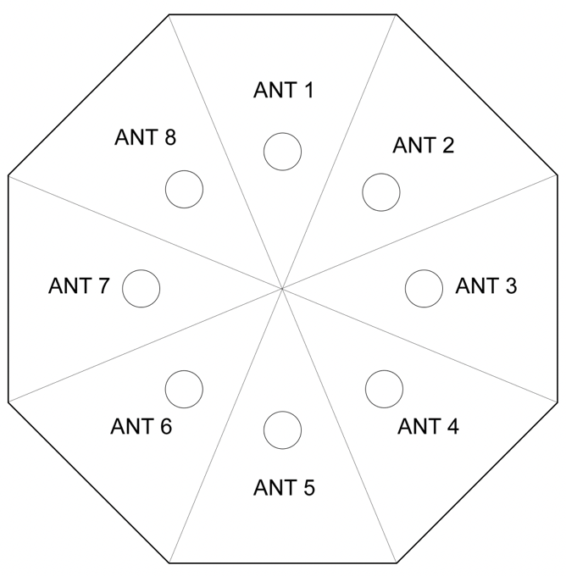
Antenna Array Design

Slide 6
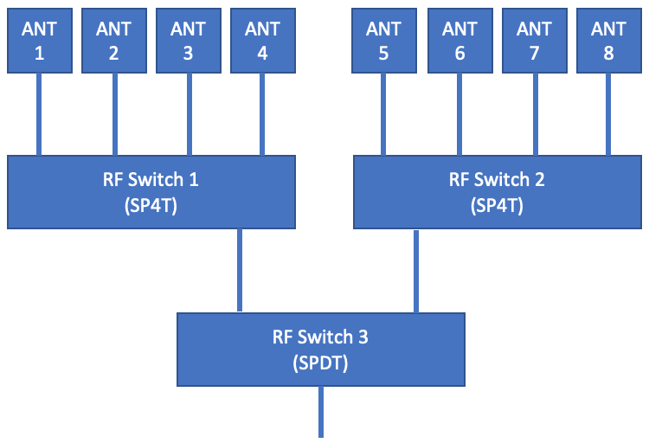
Antenna Switching

Slide 7
Functional Requirements
3.1.1) The system shall prevent a signal from being detected by more than antenna by using copper deflectors
3.1.2) The system shall be able to receive a 5GHz signal for interpretation using the antenna array
3.1.3) The system shall switch between which antenna is currently inputting data into the system
3.1.4) The system shall filter out noise using the bandpass filters
3.1.5) The system shall amplify the signal through the LNA
3.1.6) The system shall process signal from analog to digital through the SDR
3.1.7) The system shall analyze the signal through the algorithm ran on the computer
3.1.8) The system shall determine the DoA of the 5GHz signal
3.1.9) The system shall display the DoA of the 5GHz signal
3.1.10) The system shall display the characteristics of the 5GHz signal
3.1.11) The system shall repeat the process starting from functional requirement 1 once functional requirements 8 and 9 are met

Slide 8
Interface Requirements
3.2.1) The system shall turn on when a switch is flipped to the ON position
3.2.2) The system shall turn off when a switch is flipped to the OFF position

Slide 9
User and Human Factors Requirements
3.3.1) The system shall operate outdoors during clear weather conditions.

Slide 10
Documentation Requirements
1) The documentation shall be understandable to those of at least a high school level of education

Slide 11
Resource Requirements
1) The system shall require components that can be purchased from vendors only
2) The price of components to build the system shall be less than or equal $1,500

Slide 12
Quality Assurance Requirements
1) The system shall be portable enough that only one individual is needed to move it

